Slide 1
OWASP SAMM
and other Software Security Assurance Frameworks
August Johnson
Notes:
Hi, I’m
Primarily SAMM

Slide 2
Who the hell am I?
Security Architect at Netsmart Technologies
Notes:
Software companies
never a coder.
build more secure software, and improve existing software.
Some previous experience building SAPs, but I netsmart the scale was larger.

Slide 3
Software Security Assurance
Process that helps design and implement software that protects the data and resources contained in and controlled by the software.
Notes:
broad process
Applies - software creation and modification.
Purpose: “protect the data and resources that the software touches.”
Logs
PHI
Credit Card numbers

Slide 4
Software Security Assurance - Who is it for?
If you have involvement or influence in the creation or maintenance of software, there are items in here that can apply to you.
Notes:
Who sees improvement from - fully implemented?
Really anyone who uses the software benefits.
Process benefits for those who and indirectly interact with software development processes.
Application Security specialists
Developers.
CISOs
Internal Auditors, Compliance folks.
Third party testers.
Even operational folks in the scenarios that you’re operating internally developed software.

Slide 5
Common Models
ISO 27034
NIST SP-800-64
Microsoft SDL (Security Development Lifecycle)
BSIMM (Building Security In Maturity Model)
OWASP SAMM (Software Assurance Maturity Model)
Notes:
Anyone in the room knows if their org is leveraging any of these?

Slide 6
2017
2016
2015
2014
2013
2012
2011
2010
2009
2008
2007
2006
2005
2004
2003
2002
Trustworthy Computing Memo
SAMM 1.5 Released
Microsoft Adopts SDL
OWASP SAMM Beta
ISO 27034 Initial Publish
NIST 800-64-r2
BSIMM Forked
BSIMM7 Released
Notes:
https://www.wired.com/2002/01/bill-gates-trustworthy-computing/
Trustworthy computing memo was a sea change.
Security first mindset.
Lots of frameworks built after that.

Slide 7
ISO 27034
Heavy, wordy, not user-friendly.
Only part of the standard is officially published, missing some key pieces.
Notes:
If you know ISO, you know what to expect.
* Process based approach.
* Defines application security not as the state of security of an application system (the results of the process) but as “a process an organization can perform for applying controls and measurements to its applications in order the manage the risk of using them”;
* Relies on risk management processes.
parts 1, 2 & 6 published, remainder in DRAFT
* NOT FREE. In fact, you must purchase in Swiss Francs :)
Might be able to come up with a process using the draft papers. I doubt anyone will “certify” you though. http://iso27001security.com/html/27034.html

Slide 8
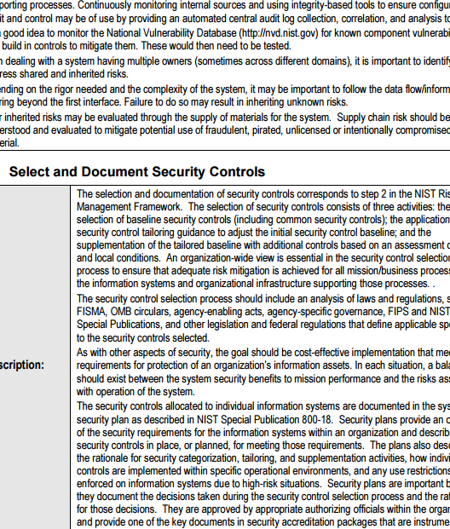
NIST SP-800-64
Gov’t only.
Giant, headache inducing wall of text.
Free!
Actually lays things out pretty decently once you get into it, if a bit dated.
Notes:
A little dated, it came out the same time as the iPhone 3G
* Only supposed to apply to gov't organizations.
* Practical tips for legacy, monolithic, waterfall type development processes.
* Readability: 0
* Practical application: Tough. No checklist of what to do next.
Example Adopter: You’re a gov’t org or contractor, so you’re used to giant head-ache inducing walls of text. You have multi-month and year projects, and a decent existing process, but you’re looking for documentation to back up and build out Secure Software Assurance activities.
http://nvlpubs.nist.gov/nistpubs/Legacy/SP/nistspecialpublication800-64r2.pdf

Slide 9
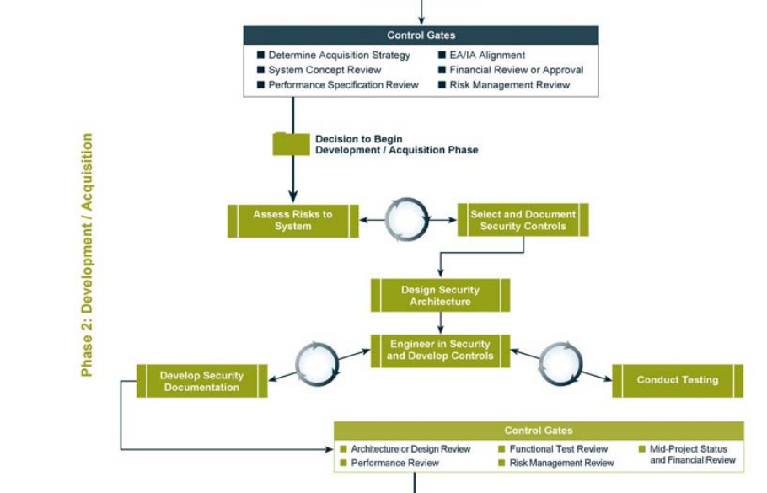
NIST SP-800-64
Notes:
Nice Charts

Slide 10
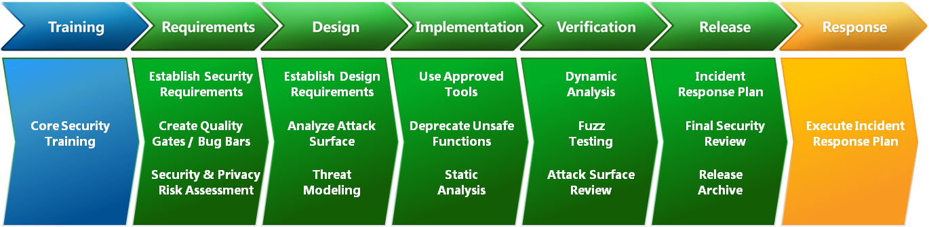
Microsoft Security Development Lifecycle
Scope is different than most of the rest.
Fairly effective if you are a similar model. (Thick client, distributed)
Notes:
Does not include governance or compliance aspects explicitly. Uses slightly different terminology than the rest of the industry. Light on the operations and governance side. Not exactly a roadmap builder.
They keep it up to date. It’s very much a living project.

Slide 11

BSIMM
Basically a big set of survey results.
Descriptive, not Prescriptive
Notes:
Free!
109 Organizations
Not a security assurance program per-se
Not “You should be doing third party pentests.” but “87% of surveyed organizations perform external pentests.”
Released yearly with new results from participating organizations

Slide 12
Measuring Real-world Practices
“Just the facts.”
In-person interview with the organizations.
BSIMM professional completing the interviews.
Notes:
Purpose: “To quantify the activities carried out by real software security initiatives.”
On Version 8.
109 Organizations surveyed, including Nvidia, Adobe, Lenovo, Verizon, Splunk, Cisco, etc. etc. Big names.

Slide 13
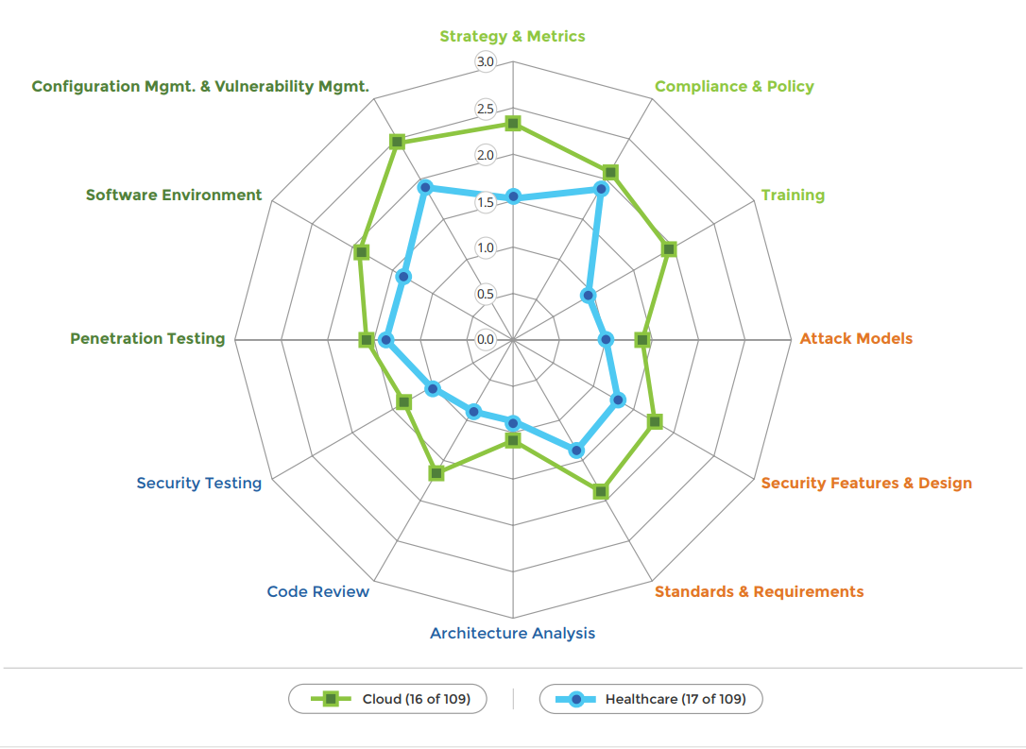

Slide 14
BSIMM - Helpful Concepts and Conclusions
Software Security Group - Internal group charged with carrying out and facilitating software security.
Everyone struggles.
Trend is definitely towards increased maturity.

Slide 15
Fun Stats from the BSIMM
Of Organizations surveyed:
67% Provide awareness training.
40% Have an operations inventory of applications.
25% Identify PII data inventory.
21% Provide penetration testers with all available information.
11% Have a bug bounty program.
Notes:
48% Educate executives.
30% Require security sign-off.
30% Publish installations guides.

Slide 16
OWASP SAMM
“...to help organizations formulate and implement a strategy for software security that is tailored for the specific risks facing the organization.”
Notes:
Software Assurance Maturity Model

Slide 17
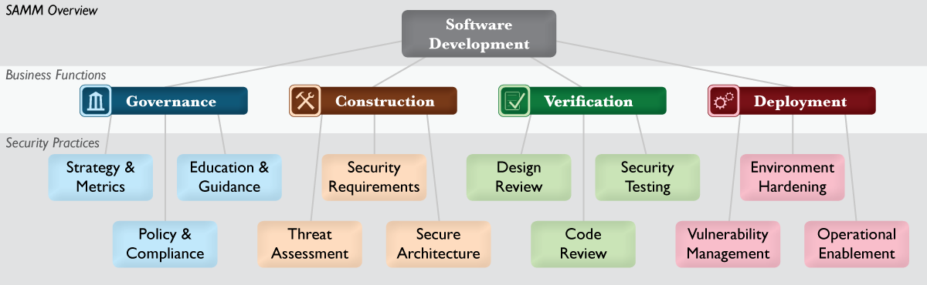
Basic Structure of the SAMM
Notes:
Maps to BSIMM’s 12

Slide 18
Governance
Strategy and Metrics
Establishing the framework
Risk classification
Policy and Compliance
Regulations and Standards
Audits
Education and Guidance
Pretty much exactly what it sounds like.
Notes:
Governance is about how an organization manages overall software dev activities. Cross functional groups, and business processes are managed here.
S&M defines ways to look at the org’s real business risk
Making sure program is aligned.
It gets more and more granular as the program matures.
Laying out metrics to truly measure the RIGHT things in the org.
Tuning, changing over time.
P&C These are big drivers to the security program
Many orgs already have people doing this.
HIPAA, NIST, PCI, HITRUST, etc.
Which apply? How do they change over time? Are we watching them?
Do the people making the software have the resources they need to understand these items?
Is deep analysis done to make sure we understand what applies where?
Project Visibility
Audits
Education and Guidance
Keeping the tools sharp, for all personnel that help build software.
Deep Dive in a few slides

Slide 19
Construction
Threat Assessment
Identifying explicit threats at a project level.
Weighting those threats.
Security Requirements
Proactively specifying expected behavior
More mature: pushing requirements to suppliers.
Secure Architecture
“Build secure software by default.”
Reusable service and components, approved frameworks, centralized services.
Notes:
How an organization defines goals and creates software within development projects.
Threat modeling.
Example: Netsmart has products that store medical records. HIPAA stuff.
In the vast majority of cases, these are not exposed to the internet.
Prioritize attacks from privileged users looking to overprescribe drugs and cover their tracks.
Security Requirements.
They straight up won’t be thought in many organizations.
Why is our session timeout? Someone asked to change it to an hour? Is that OK?
Documented Requirements help to solve these issues.
Aligning what is asked of developers to what the organization truly needs to accomplish.
Bedrock of successful software.
They’ll definitely change over time. Should be generally platform independent.
Secure Architecture
“Secure by default” is the key. It’s simply easier to use secure pieces than to DIY
Maybe the organization should move away from PHP, Struts, and Wordpress?
Security-specific reviews for new technologies being used and implemented.
Reference Architecture, Audits, etc are keys here to reaching full maturity.

Slide 20
Verification
Design Review
Detect architecture-level issues.
Evolves towards formal inspection, and baselines for design assessments.
Implementation Review
More eyes on code means less bugs and vulnerabilities.
Automation (SASTs)
Security Testing
Runtime Inspection, human, robot, and otherwise.
Notes:
About how an organization checks and test artifacts produced in software development.
DR
Identifying software attack surface.
This also keys off of security requirements heavily. Does the code use the required algorithms? Encrypted databases?
DR2 = “Design review as a service” in the organization. On-demand design reviews, you provide the visios, we provide the critiques.
DR3 = Data flow diagrams for sensitive data
And Design review is an ENFORCED gate within the lifecycle.
Implementation Review = Code Review
Deep dive on this one in a few slides.
Security Testing
Basic tests performed on major releases.
Pentests performed as part of the software process not just a yearly checkbox.
Automating using tools like ZAP, w3af, stuff like that.
Application specific security automation
Selenium test that exercise the security features.
Automation service-level tests that measure all of the authentication states.
Kind of a common refrain.
Start small,
add automation,
Enforce.

Slide 21
Operations
Issue Management
Have an incident response process, to start with.
Go from there.
Environment Hardening
Patching.
Monitoring.
Operational Enablement
Kind of like the user manual for the operators of the software.
“Formal operational security guidelines.”
Notes:
Operations is how an organization manages software releases. Shipping to end users, deploying to internal or external hosts, and normal operations in a runtime environment.
Issue Management is about incident response.
Scope of SAMM is software, flavored for incidents in-house software-related.
Consistency, communication, disclosure process are important parts of level 2.
3 - Root cause analysis and deep metric collection.
Environment Hardening,
basically patching and monitoring of the hosts running the software.
Going to do a deep dive on this one.
OE
Communication between the development teams and operators of the actual software.
Specifically security data.
Documentation, consistent channels of communication.
Change management is part of this.
Auditing operational environments and configurations.
Code signing is specifically mentioned. So you can verify integrity.

Slide 22
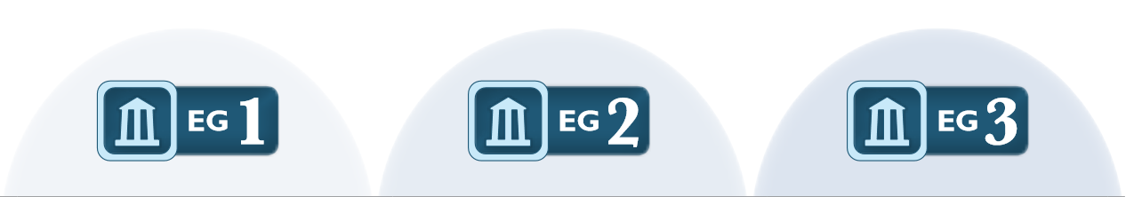
Deep dive: Education and Guidance 1 - 3
EG1 Objective: “Offer development staff access to resources around topics of secure programming and deployment.”
EG2 Activities: * Conduct role specific application security training. * Utilize security coaches to enhance project teams
EG3 Results: Efficient remediation of vulnerabilities in both ongoing and legacy code bases.
Notes:
EG1 Activities: Technical security awareness training
Like OWASP top 10 for devs.
Build and maintain technical guidelines.
Say, a wiki with some basic technical guidelines, like we use C# .NET4 stack, and Microsoft's products where possible.
Metrics: (example from OWASP… mix and match as necessary).
>50% development staff briefed on security issues in the past year
>75% senior development/architect staff briefed on security issues within the past year.
Costs estimate
Training course license
Ongoing maintenance of wiki
EG2
Role specific training
Project Managers, developers, DBAs, BAs, architects.
Utilize “Security coaches” to enhance project teams.
Idea is 10% of a very skilled individual’s time can be dedicated towards security consultation. These people get extra training.
EG3
Create formal application security support portal
Establish role-based examination/certification.
You are a certified security badass, and you have taken training and an exam provinig that.
Implies those things exist.

Slide 23
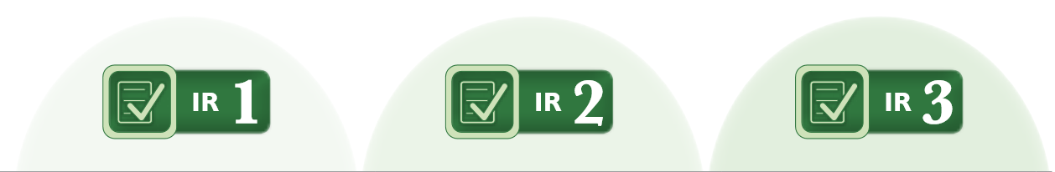
Deep Dive: Implementation Review 1 - 3
AKA Code Review
Starts with checklists and point-reviews.
Proceeds to automation, and significant integration of that tool.
Ends with enforced, objective goals for judging code-level security.
Notes:
Two activities in Implementation review 1:
Create review checklists FROM known security requirements
Perform point-review of high risk code.
Metrics example:
>80% of project teams briefed on relevant code review checklists in past 6 months
Level 2:
Activities are picking an automated code analysis tool.
Integrating that tool into the development process.
Metrics example:
>80% of projects with access to automated code review results in past 1 month
>50% of projects with code review and stakeholder sign-off in past 6 months
Accomplishments of IR2
Development enabled to consistently self-check for code-level security vulnerabilities
Routine analysis results to compile historic data on per-team secure coding habits
Stakeholders aware of unmitigated vulnerabilities to support better tradeoff analysis
Level3:
Customize code analysis for application-specific concerns.
I.e. Specifying queries for app-specific vulnerabilities, i.e. inappropriate implementation of roles on an object.
Establish release gates for code review
“No new high vulnerabilities” is the start
“Maximum of 0 highs, and 50 mediums” is next.
Success metrics:
>75% of projects passing code review audit in past 6 months

Slide 24

Deep Dive: Environment Hardening 1 - 3
Understand baseline operational environment for applications and software.
Establish reliable patching and monitoring systems.
Deploy protection tools, and expand audit program.
Notes:
Tools like SCCM and Puppet come into play here, as well as just plain old documentation.
The idea is that you continue to gain confidence that all the hosts in your environment are healthy, and that they will remain so.
First you define health, the kind of go from there.
Environment Hardening
1: Have actual documentation. Tougher than you think
“Identify and install critical security upgrades and patches”
Security updates to third-party components. Not as easy as you may think, how many old jquery versions are there referenced in your site?
2. Routine process
Monitoring against the baseline.
Formal expectations.
3. Expanding the audit program for environment config.
Awareness of different tools?
F5 WAF is available! But do the devs know?

Slide 25
Tools available for the SAMM
Great big PDF
Wiki, with about 85% of the content of the PDF.
SAMM_Assessment_Toolbox_v1.5_FINAL.xlsx
Notes:
72 page pdf.
Wiki is really just missing some of the charts that are there because the document isn’t hyperlinked. You can do everything on the wiki.
Nick Coblentz, local, of SecurityPS gets authorship credit on the assessment XLSX

Slide 26
Self-Assessment
One of the first steps.
How bad is it?
Probably not as bad as you fear, but definitely not great.
Notes:
Asking a few people from around the organization different questions.
Very unlikely that one person could answer, but it might be possible in a smaller org.
From governance processes to server patching documentation, it’s all in the questionnaire.

Slide 27
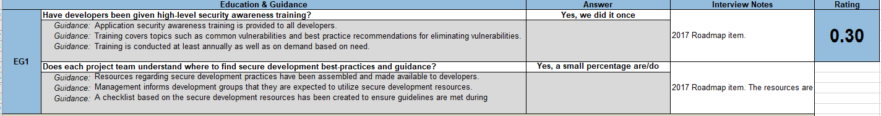
Self-Assessment - Lightweight
(AUDIENCE PARTICIPATION)
Notes:
EG1
Have developers been given high-level security awareness training?
No
Yes, we did it once
Yes, we do it every few years
Yes, we do it at least annually
Does each project team understand where to find secure development best-practices and guidance?
No
Yes, a small percentage are/do
Yes, at least half
Yes, a majority
Does the secure design review process incorporate detailed data-level analysis?
Woah, this definitely has some pieces that need to be built before we can consider this.

Slide 28
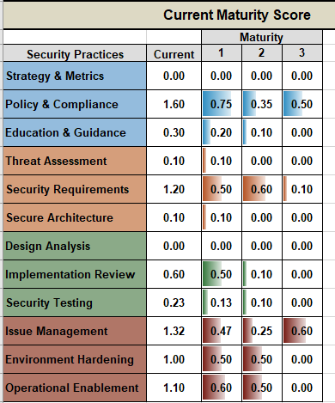
Assessment Results

Slide 29
Self-Assessment - Detailed
Prove it!
This is what happens at the end of every phase.
Forever...
Notes:
Very similar to the Lightweight assessment in content, but requires proof.
Basically an audit, but everyone is usually pretty friendly.
Lots of the metrics are pretty easy to collect, or can be collected in an automated fashion.

Slide 30
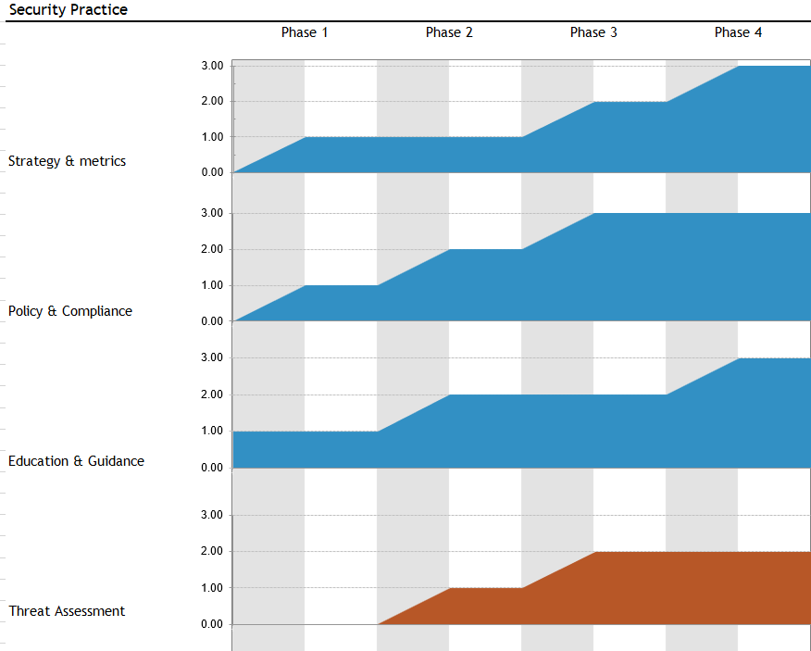
Building a Roadmap
Start where you can.
Align to stuff that’s in-flight already.
Use the tools.
Notes:
Partial maturity levels?
IMHO, easiest to just assume that it’s a minimum type thing.
Length of Phases is a pretty big decision point.
3mo/6mo are the two I would recommend, and align with budgetary cycles.
Number of phases honestly doesn’t matter that much right at first, but it’s nice to plan it out.

Slide 31
Building a Roadmap - Examples
Small, agile organization with key pieces in place.
Monolithic, resistant to change organization.
Heavily remote organization with diverse technology stacks and siloed teams.
Notes:
Small, security focused organization might start with level 1 or even 2 maturity in some practices.
Shorter phases to shore up the bases.
It will be a focus for the individuals required.
Leadership commitment.
Procurement process can take months for tools sometimes.
Culture changes
Understaffed
Shorter phases, but less in them maybe?
Communication is key with remote teams.
Siloes really do mean you have to push things out multiple times.

Slide 32

Setting Metrics
Defining groups/people is harder than you think.
You don’t have to use the ones they pick!
Make them testable and gatherable.
Pick your percentages. Plan to crank them up.
Notes:
Example Metrics:
SM3 >80% of projects reporting security costs in the past three months.
PC1 >1 compliance discovery meeting in the past six months.
SA1>80% of development staff briefed on software framework.
IR2 >50% of project teams performing code review on high-risk code in the past 6mo
ST3 >50% of projects using security testing customizations.

Slide 33
Executing your Roadmap
Based on organization size and agility, pick your phase length.
Pick your end goals.
Calculate the difference, and lay it out in the phases.
Tweak it.
Tweak it some more.
Notes:
Phase Length, really either 3m or 6m
Only build out the detailed steps and metrics for the phase you’re in
don’t even work on the next phase until late current phase.
You’ll miss metrics, and have to roll them over.

Slide 34
I did it! What now?
Eh, it never really ends.
The end of the last phase means you have ongoing activities and audits.
Keep upping your metrics. “100% of devs get 1 on 1 training from drunk Steve Ballmer himself, daily.”
Notes:
Improve your audits and tests of your process.
You can always automate something else.
Tech changes too fast to actually be “done.”

Slide 35
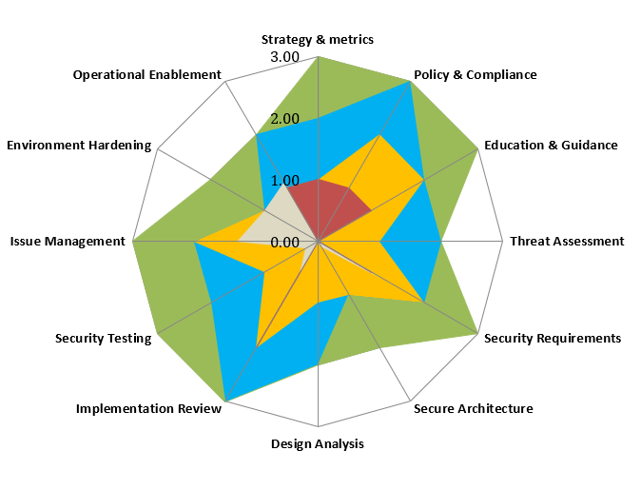
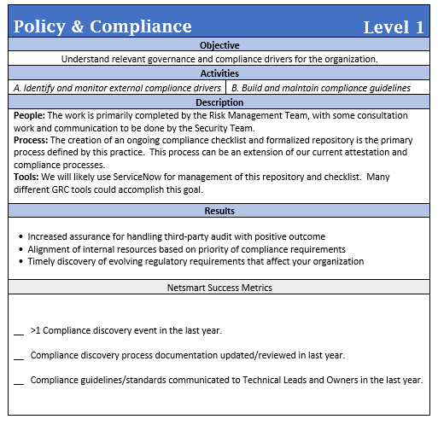
In Practice - Observations So Far
Notes:
Easy to use.
Impressive output, easily worthy of C level presentations.
Polish.
Actually a solid roadmap from what I can tell. Legitimate progress has been made.
Lots of areas that security has less influence over, so lots of lunch-buying and favors.

Slide 36
Getting Started
Maybe start with the BSIMM even?
Pick one area that you have some influence over, and measure yourself.
Push for change!
Notes:
Survey yourself, get a bit of perspective.
Check which initiatives that are in-flight line up with the SAMM.

Slide 37
Questions?
august.johnson@gmail.com
@august on seckc.slack.com
keybase.io/augustjohnson
github.com/augustjohnson

